Slide 1
Financial Complaint Analysis and Workload Reduction Strategies

Slide 2
TABLE OF CONTENTS
01
02
03
INTRODUCTION
PROBLEMS
RECOMMENDATION

Slide 3
01
INTRODUCTION

Slide 4
INTRODUCTION
This project aims to conduct a business intelligence-driven investigation through the analysis of financial complaints. The financial complaints in our application were analyzed in relation to specific platforms and resolution response types, and significant trends and relationships were revealed using exploratory data analysis and statistical tests. The main objective of these analyses is to increase customer satisfaction and reduce the workload of call center employees by 20%.

Slide 5
02
PROBLEMS

Slide 6
PROBLEMS
PLATFORM
Do the platform complained about make a difference for issues resolved in more than 7 days?
FEEDBACK
Is there a correlation between the response to resolution and customer feedback?

Slide 7
PLATFORM

Slide 8
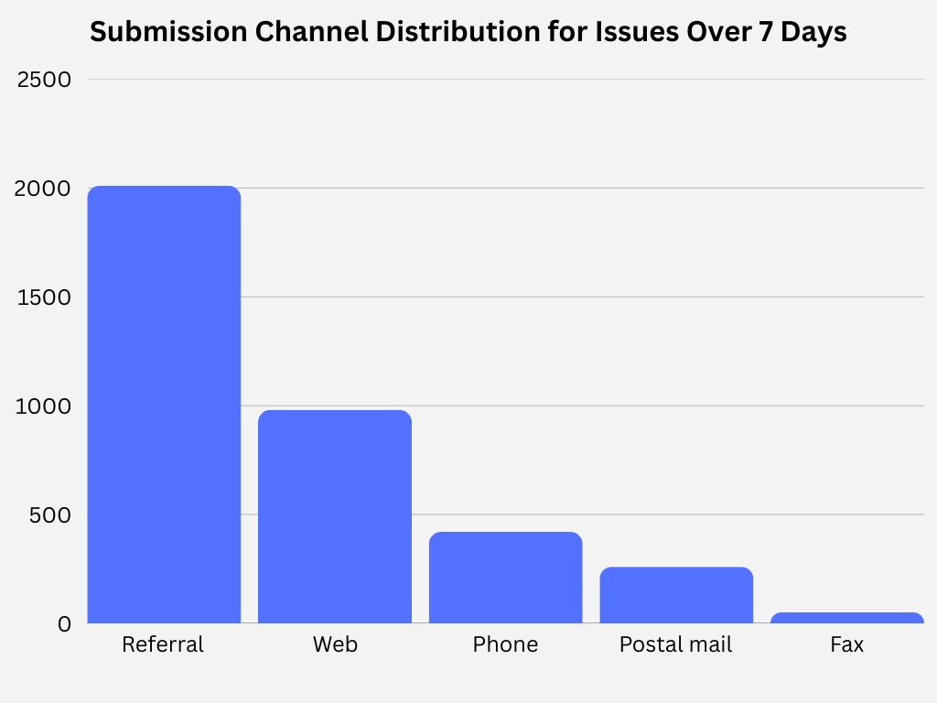
PLATFORM
Do the platform complained about make a difference for issues resolved in more than 7 days?
The answer is yes, the Referral channel contains by far the highest number of complaints compared to all other submission channels. Complaints through Referral are about 100% higher than Web complaints and about 300% higher than Phone complaints. As a result of the statistical tests, it was determined that this difference was not due to a random situation and that there was a significant relationship.
Let's analyze referral a little more

Slide 9
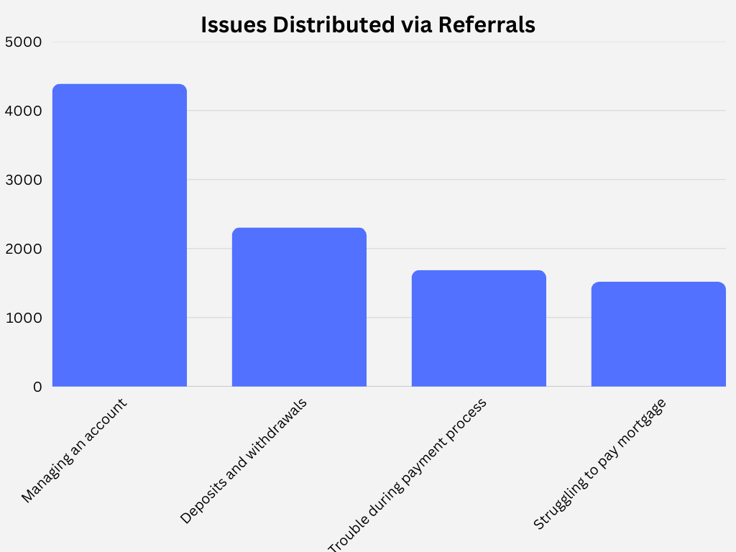
What is the distribution of complaints received through referrals?
The distribution of issues reported by our customers through referrals indicates a significant bottleneck in account management. Problems in tracking and processing customer account information during referral processes exceed the total of all other categories combined. This data suggests that when customers are redirected between different departments, their account information is not being transferred accurately.

Slide 10
FEEDBACK

Slide 11
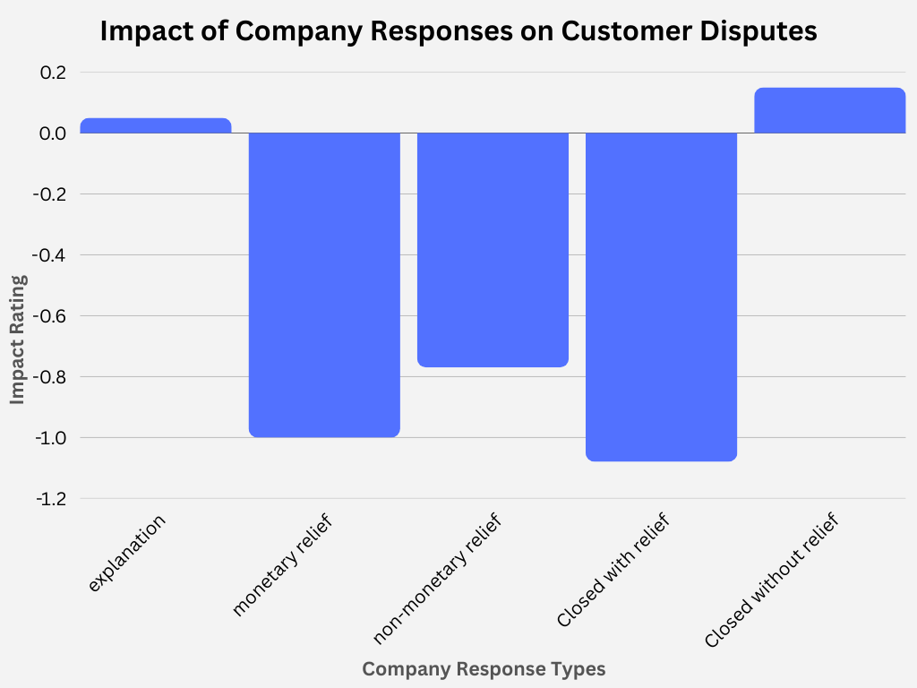
FEEDBACK
Is there a link between the answer given for the solution and the feedback of the customers?
Closed with relief, i.e. the provision of a solution in general terms, is the method that most reduces the likelihood that customers will complain again. Closed with monetary relief is also very effective, indicating that customers are satisfied that they have received a financial response to their complaint. The least effective method is Closed with explanation. This may indicate that just giving an explanation is not enough to ensure customer satisfaction and that the complaint requires a solution.

Slide 12
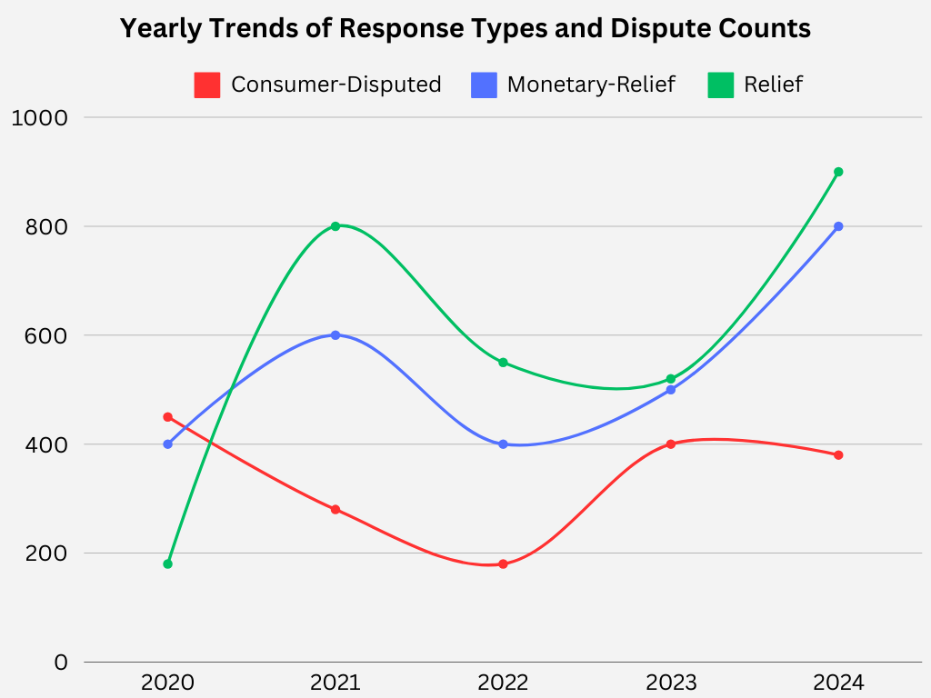
What is the annual graph of consumers discussed with the answers given?
Analyzing the graph, it is clear that proactively providing assistance and financial relief is effective in reducing disputes. Particularly between 2020-2022, the noticeable increase in the Monetary Relief and Relief categories directly coincides with the decline in the Consumer Disputed category, highlighting the impact of proactive solutions on customer satisfaction. However, the rise in disputes between 2022-2023 suggests that the strategy needs to be continuously reviewed. The 2024 data may indicate that recent improvements are once again yielding positive results.

Slide 13
01
RECOMMENDATIONS

Slide 14
RECOMMENDATIONS
FOR PLATFORM
FOR FEEDBACK
Account Information Passport
Creating an account information passport to ensure seamless and secure information flow between departments.
Mandatory Information Control in Routing
Processes Implementing mandatory information control steps in routing processes to minimize missing or incorrect data entries. This prevents departments from proceeding with incomplete information, ensuring a smooth workflow and eliminating delays.
User-Friendly Interface and Guidance
Designing a more user-friendly interface and providing guidance through interactive tutorials to simplify complex like account management tasks.
Instead of merely providing explanations, adopt an approach of offering support in every situation, ensuring that users receive tangible assistance rather than just guidance when faced with challenges.
Başarılı çözüm örneklerinden oluşan bir uygulama kütüphanesi oluşturarak, geçmişte etkili sonuçlar veren yaklaşımları merkezi bir yerde toplama. Böylece benzer sorunlarla karşılaşan kullanıcılar, kanıtlanmış çözümlere hızlıca erişebilir.

Slide 15
THANK YOU Do you have any questions?

Slide 16
Instructions for use
If you have a free account, in order to use this template, you must credit Slidesgo by keeping the Thanks slide
As a Free user, you are allowed to:
Modify this template
Use it for both personal and commercial projects
You are not allowed to:
Sublicense, sell or rent any of Slidesgo Content
Distribute Slidesgo Content unless it has been expressly authorized by Slidesgo
Include Slidesgo Content in an online or offline database or file
Offer Slidesgo templates (or modified versions of Slidesgo templates) for download
Acquire the copyright of
Slidesgo Content
For more information about editing slides, please read our FAQs or visit our blog

Slide 17
Instructions for use (premium users)
As a Premium user, you can use this template without attributing Slidesgo or keeping the Thanks slide
You are allowed to:
Modify this template
Use it for both personal and commercial projects
Share this template in an
editable format
Hide or delete the “Thanks” slide and the mention to Slidesgo in the credits
You are not allowed to:
Sublicense, sell or rent any of Slidesgo Content
Distribute Slidesgo Content unless it has been expressly authorized by Slidesgo
Use any of the elements that are part in a separated way
Register any of the elements as a trademark or logo in an intellectual property registry
For more information about editing slides, please read our FAQs or visit our blog

Slide 18
Fonts
Colors
This presentation has been made using the following fonts:
All the colors used in this presentation
Click on the button of the link to the fonts
#000000
#f3f3f3
#76a5af
Urbanist
#134f5c
#0c343d
#bed4d8
Open Sans
To view this template correctly in PowerPoint, download and install the fonts we used

Slide 19
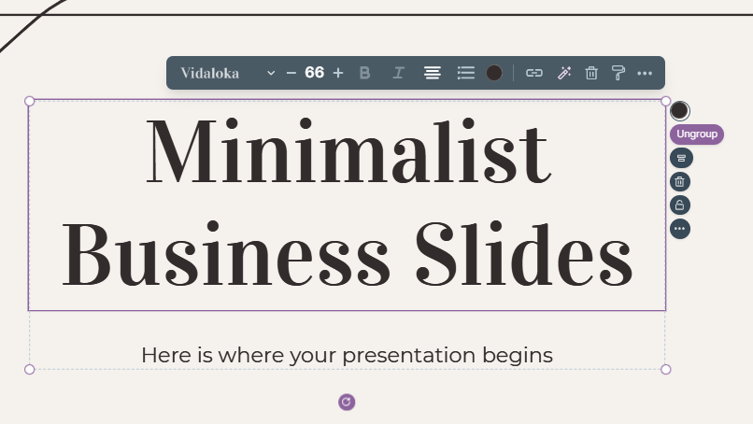
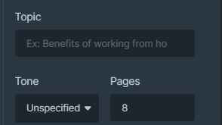
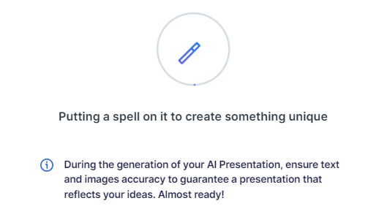
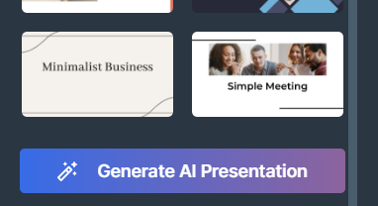
Presentation Maker
Slidesgo introduces its latest feature: the Presentation Maker. Enjoy two main functionalities - firstly, with a few clicks, create marvelous presentations with Artificial Intelligence that adapt to your needs. And it's completely free!
The second functionality of this tool is that you can edit presentations through the online editor. Create interactive resources easily, quickly and without the need for any software. Change everything or start from scratch
Generate AI Presentation
Edit online

Slide 20
Use our editable graphic resources...
You can easily resize these resources without losing quality. To change the color, just ungroup the resource and click on the object you want to change. You can also look for more infographics on Slidesgo

Slide 23
 | Jan | Feb | Mar | Apr | Jun
Task 1
Task 2
Task 3
 | No | Yes | Yes | No | Yes
 | Yes | No | Yes | No | Yes
 | Yes | Yes | No | Yes | No
 | Jan | Feb | Mar | Apr | Jun
Task 1
Task 2
Task 3

Slide 25
6/10 | 8/10 | 7/10 | 4/10

Slide 26
...and our sets of editable icons
You can resize these icons without losing quality
You can change the stroke and fill color; just select the icon and click on the paint bucket/pen
In Google Slides, you can also use Flaticon’s extension, allowing you to customize and add even more icons

Slide 27
Educational icons
Medical icons

Slide 28
Business icons
Teamwork icons

Slide 29
Help & support icons
Avatar icons

Slide 30
Creative process icons
Performing arts icons

Slide 31
Nature icons

Slide 32
SEO & marketing icons

Slide 33
Premium infographics
Mercury
Mars
Venus
Mercury is the closest planet to the Sun and smallest one
Despite being red, Mars is actually a very cold place
The Solar System
2xxx
2xxx
2xxx
2xxx
2xxx
Venus is the second planet from the Sun and is terribly hot
Jupiter is a gas giant and the biggest planet in the Solar System
Saturn is a gas giant and has several and beautiful rings
Earth
Jupiter
Saturn

Slide 34
Premium infographics
75%
15%
Mars is very cold
30%
Jupiter is a gas giant
Mercury
Mercury is the closest planet to the Sun and the smallest of them all
75%
30%
Saturn has rings

Slide 35
Premium icons
Digital marketing

Slide 36
Premium icons
Online learning

Slide 37
Premium icons
Laboratory

Slide 38
Premium icons
Goals & results

Slide 39
Premium icons
Infographic elements

Slide 40


